Slide 1
Ofsted Update from the Diocese of Chichester Thank you to Steyning CE Primary for the lovely photos

Slide 2
Changes No one judgement for overall effectiveness Monday phone call alert Wednesday inspections completed ‘Suspend and return’ policy for safeguarding concerns

Slide 3
Changes on the ground!
Gentler approach – constantly checking that staff and head are comfortable
Feedback - governors and staff can share the outcomes with a trusted person so long as it remains confidential.

Slide 4
What we are noticing
Data is becoming more important again.
Inspectors are out and about more around the school.

Slide 5
Still in focus
Ambitious, well-planned and sequenced curriculum which builds towards clear end-points
Use of assessment to inform teaching
High quality work – high expectations
Pedagogy – focus on how children learn to commit to long term memory so they know more, remember more and can do more.
SEND – adaptation so all children can access learning
Early reading and phonics
Broad curriculum offer – visits, visitors and clubs

Slide 6
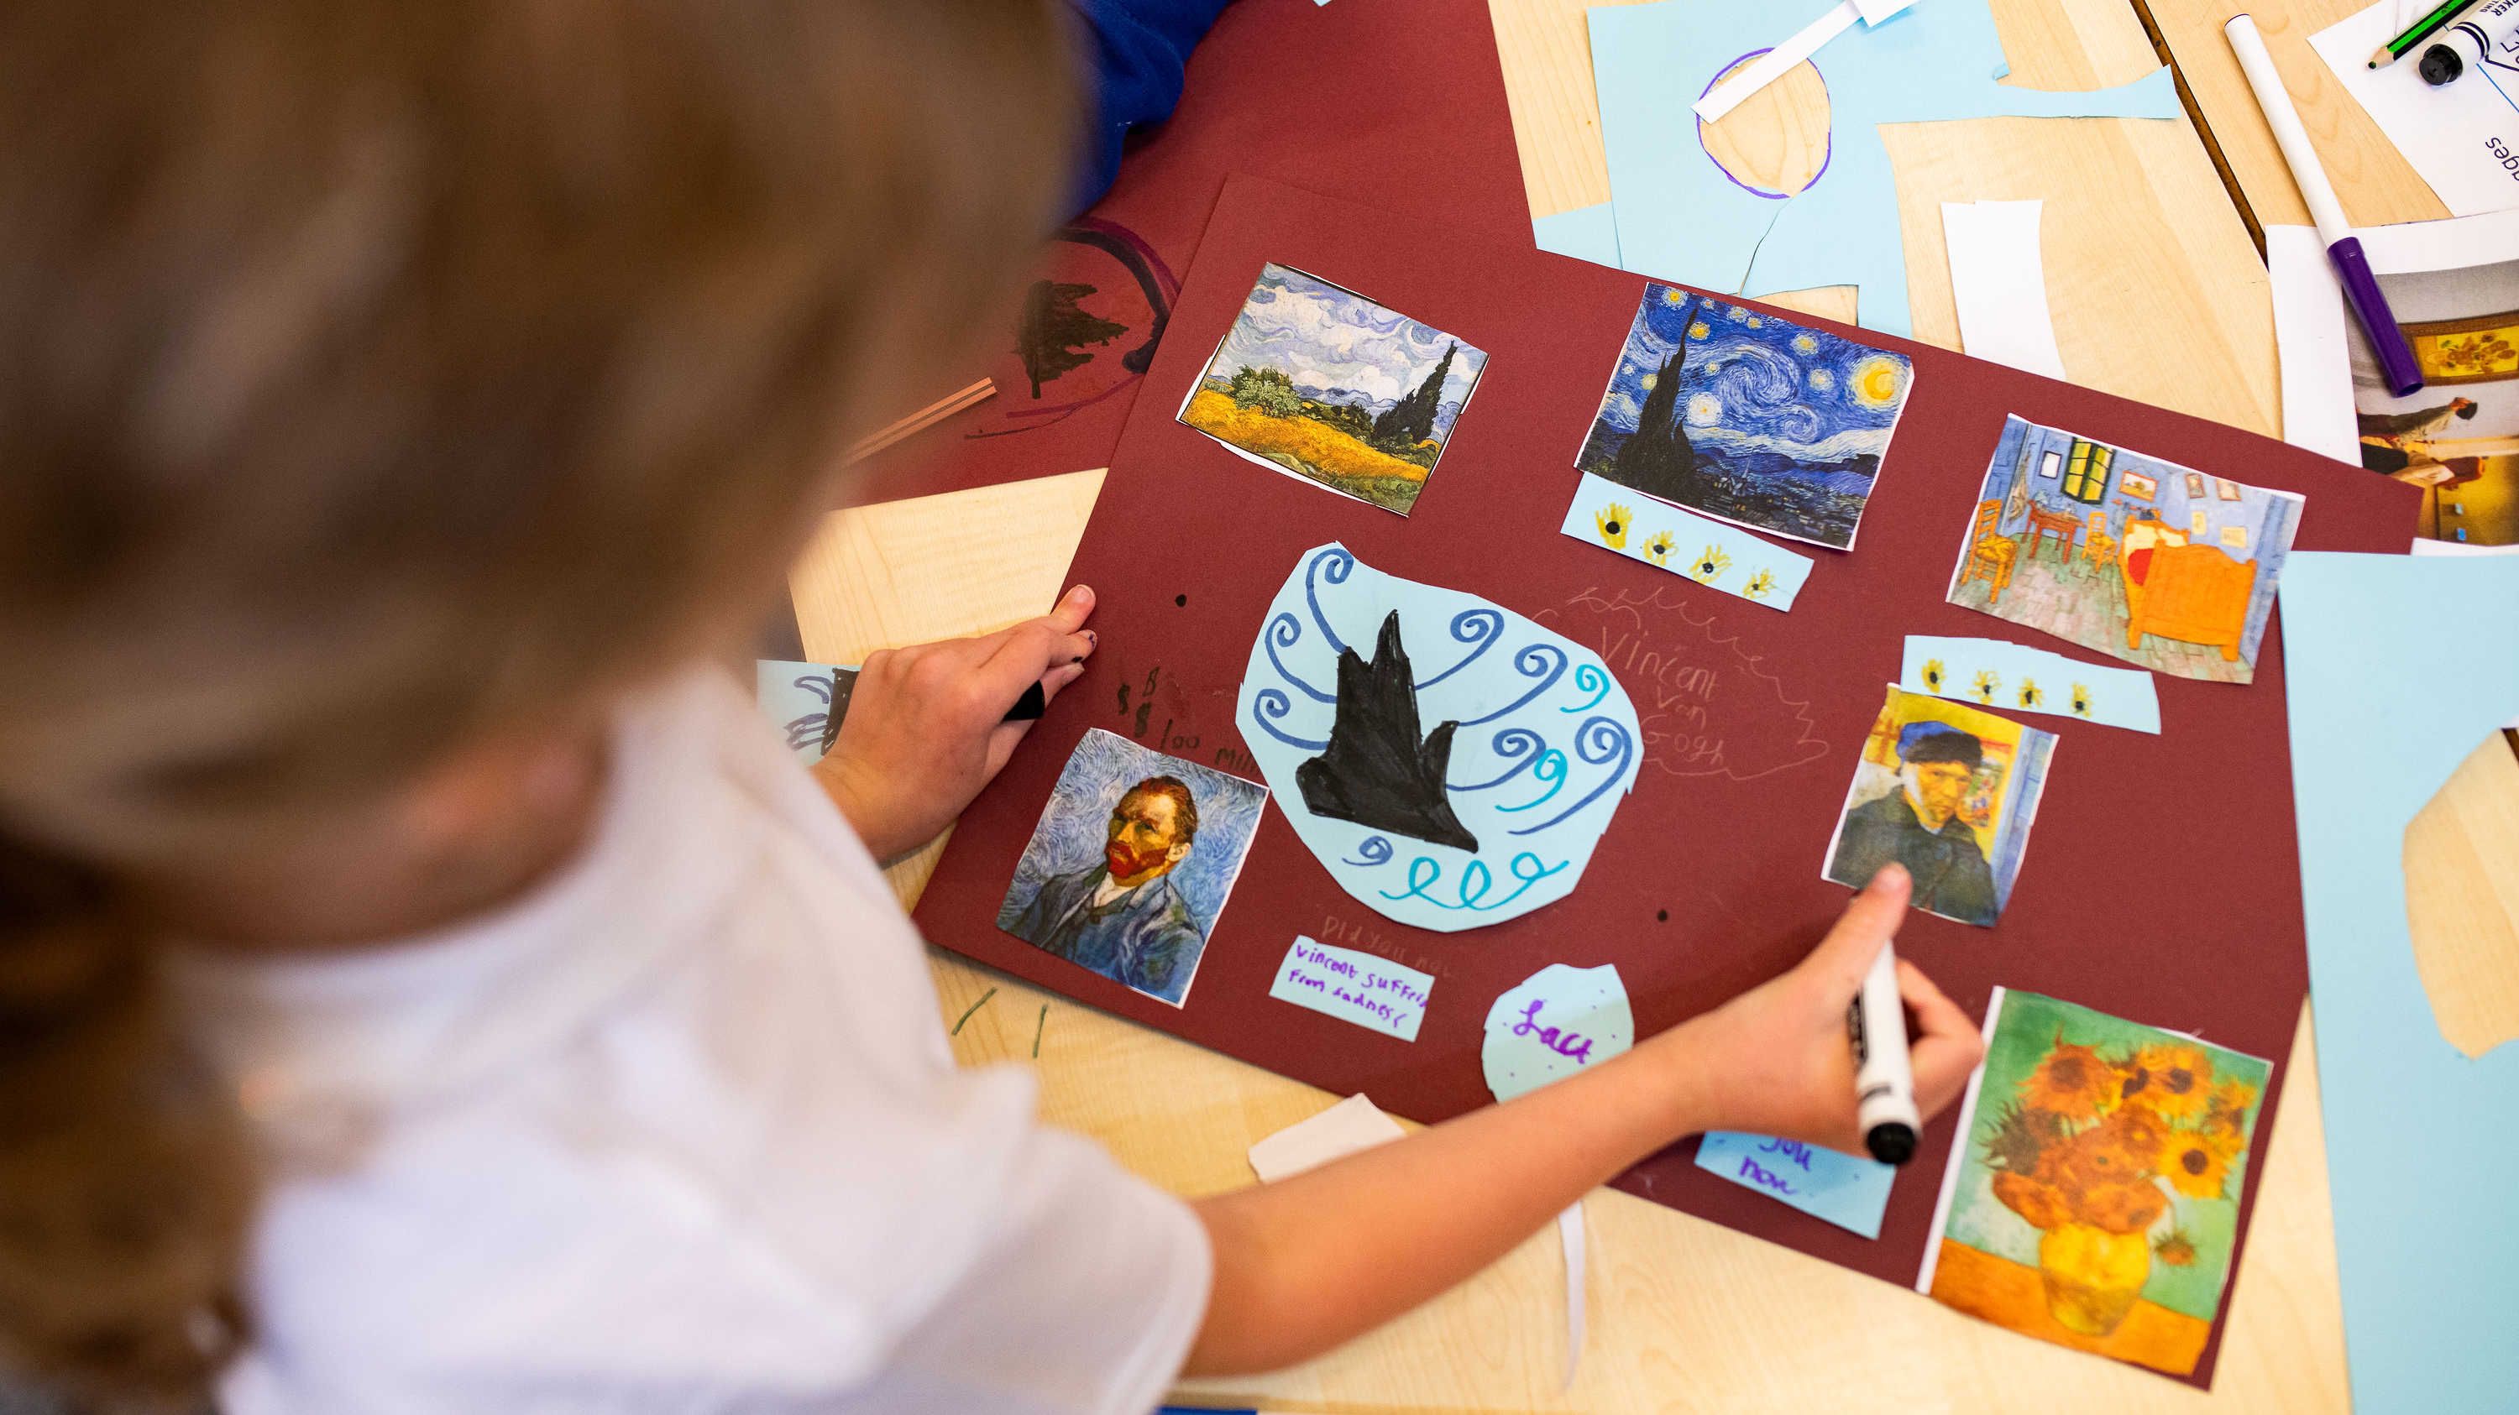
Your own checks…
End-points of learning are on display
The breadth of the curriculum learning is evident in classrooms
High expectations are evident in books and behaviour
Children work collaboratively to apply learning
Learning tasks challenge children to demonstrate how much they know and have learned

Slide 7
Listen to everyone
Evaluate the evidence

