Slide 1
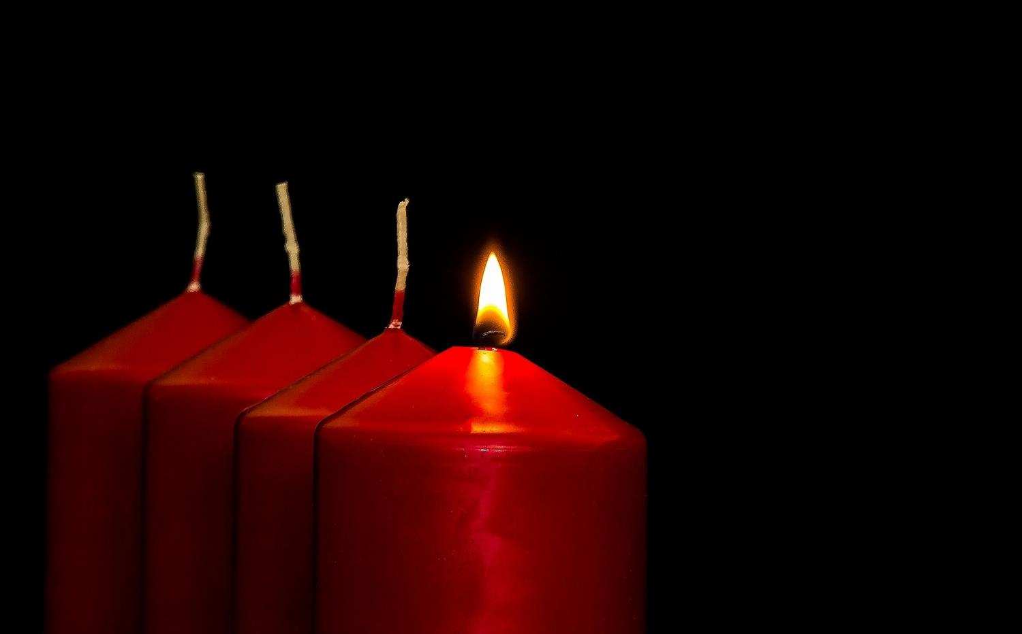
Leader: As we light our Advent candle…
All: May today’s story show us something new, like light in the darkness.
Notes:
Slide 1: Use this special greeting for the Advent season, as you light your Advent candle.

Slide 2
Notes:
Slide 2: I wonder who’s in your family? Talk together about immediate and wider family, such as cousins, and grandparents – and whether children know anything about people from further back in their family history. [Remember that there are many different models of family, and that some children may not know much – or wish to divulge much – about their family. If it helps, use your own family, with photos if you like, as an illustration: you are just wanting children to get an idea that families can be quite big – and go back through time.] People sometimes call this their ‘family tree’ because each part of their family history is like a branch, that grows and spreads out over time.

Slide 3
A very special Advent calendar
Notes:
Slide 3: In a few moments, we’re going to find out about a very special Advent calendar that will join us together as a school community, and take us through Advent together on a very big adventure through history.

Slide 4
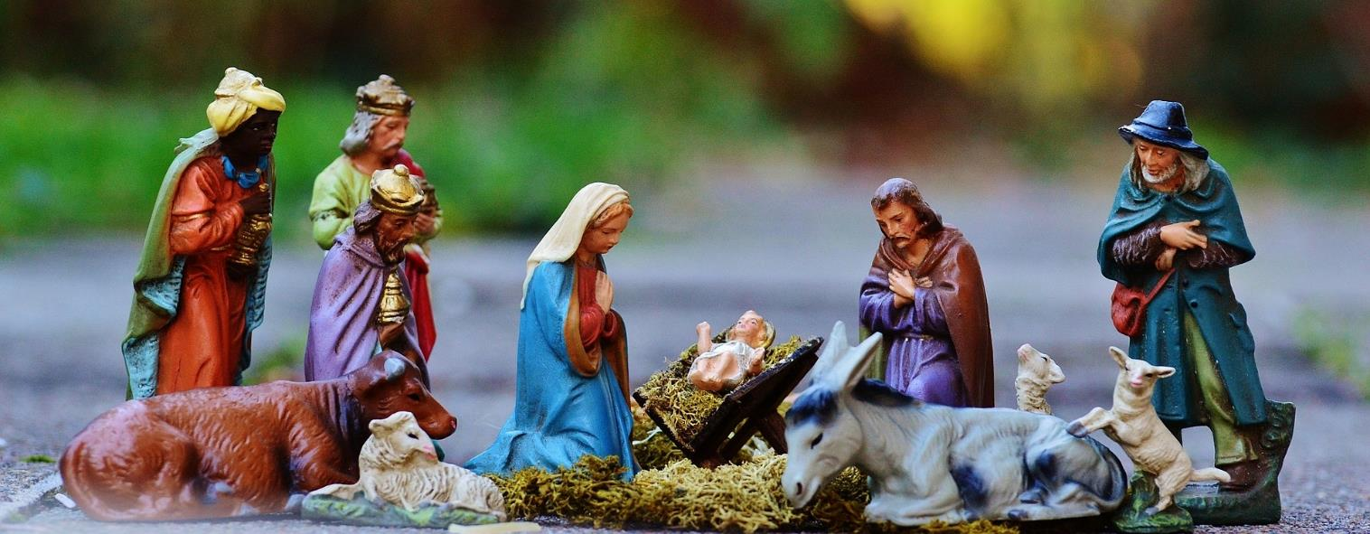
25th December
Notes:
Slide 4: But today we’re going to start in an unusual place: at the end of the Advent calendar, with the story of the birth of Jesus – the part that Christians remember on Christmas Day.

Slide 5
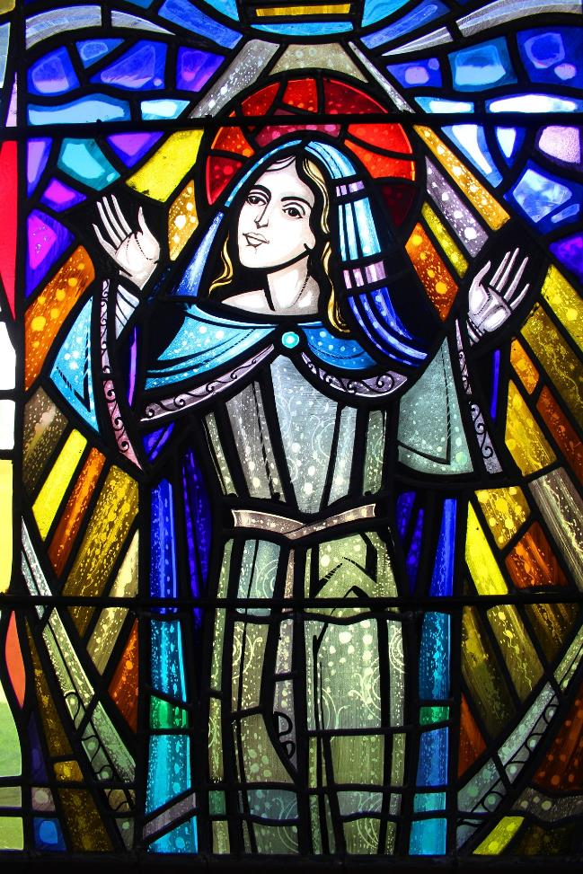
‘With all my soul I praise God; my heart is happy because God is my Saviour…..
…God has done what he promised to our ancestors, to Abraham and his family forever!’
(Luke 1: 46, 55)
Notes:
Slide 5: Like most new mums, Mary was overwhelmed with joy at the birth of her son – and spoke these words of praise [read them]. Mary had known for a long time that Jesus was not going to be any ordinary baby. Jesus would be God’s son, the great rescuer and part of a great family! Mary’s family was only just beginning, but this birth was part of a much bigger story. It’s this bigger story that we are going to explore together during Advent – and each day, we will hear something new about this great big family that Mary spoke about.

Slide 6
‘I wonder….?’
Notes:
Slide 6: Each day, we will ask some ‘wondering’ questions about the story, giving ourselves space to stop and think together.
[If using Advent calendar today] So, let’s begin this adventure into Jesus’ family history – and go right back to the beginning, with a story that comes right from the beginning of the Bible. [link to Advent calendar]

Slide 7
‘With all my soul I praise God; my heart is happy because God is my Saviour…..
…God has done what he promised to our ancestors, to Abraham and his family forever!’
(Luke 1: 46, 55)
Notes:
Slide 7: … We’re going to have some quiet moments now to begin our wondering!…..
….you might like to look at the flame of the candle as you think….
…we’ve heard about Mary’s response to the birth of Jesus…..
…listen again to her words: “God has saved his people….
….God has done what he promised to our ancestors, to Abraham and his family forever!”
…..I wonder how it felt to know that the Rescuer had come as a tiny baby?....
….I wonder if this is what people expected?....
….I wonder which stories we will share together during this Advent?....
…I wonder what they might say to us?....
Now I’m going to use a short prayer, asking God to help us as we begin this Advent adventure together. If you would like to join me, then join in with ‘Amen’ at the end – or if you prefer, just be still with your own thoughts.
Dear God
As we begin this Advent season, may our hearts be open to hear the stories of Jesus’ Big Family History. May we, like Mary, find things that will make us wonder, and give you praise.
Amen

Slide 8
Leader: As we leave this place & time…
All: May the light of Advent shine brightly in our school today.
Notes:
Sending: Slide 8 (You might want to use this slide throughout the Advent season to end your time together)
Leader: As we leave this place and time….
All: May the light of Advent shine brightly in our school today.

