Slide 1

Enter the 2020
Spirited Arts & Poetry competition
This presentation invites to you make a piece of artwork or poetry on one of our five themes.
The National Association of Teachers of RE will give prizes to the winners.
See more details on our online gallery at www.natre.org.uk

Slide 2

What is Spirited Arts & Poetry?
Spirited Arts is an annual competition run since 2004 for RE pupils. We are delighted to once again welcome Poetry entries for 2020. The competition gives you a chance to be creative and imaginative in RE. It is all about spiritual ideas and your skills.
There is a wonderful online art gallery & poetry collection. Last year over 50,000 pieces were created, and some of the best are on show there.
If you enter this year, perhaps your art or poem will be in the gallery next time! Have a look and choose some favourites of your own.
Pupils and their teachers are warmly invited to join in! We welcome entries from January of each year and the closing date is 31 July 2020. Click here to see full entry information.

Slide 3

Five themes to choose from
Spirited Arts & Poetry has five themes for 2020. Your teacher will choose a theme with you for you to enter. Have a look at some work from similar themes now.
The themes are:
God’s good earth?
Inspiring!
Holy Words!
Where is God?
Picturing Faith (New! Photo section)
Choose the one you want. After this slide you’ll see lots more information and some great examples.

Slide 4
God’s good earth? | Are we spoiling God’s good earth? Should we be thankful for it? Can we save it in time from the threats of climate change? The beauty of the earth is celebrated in many religions, but the human spoiling of the earth is a danger and a coming crisis. In this theme, learners are invited to explore ideas and beliefs about the natural world, human responsibility for the earth and ways of praying about climate justice. Great work will show some originality: the globe in God’s hands won’t win!

Slide 5
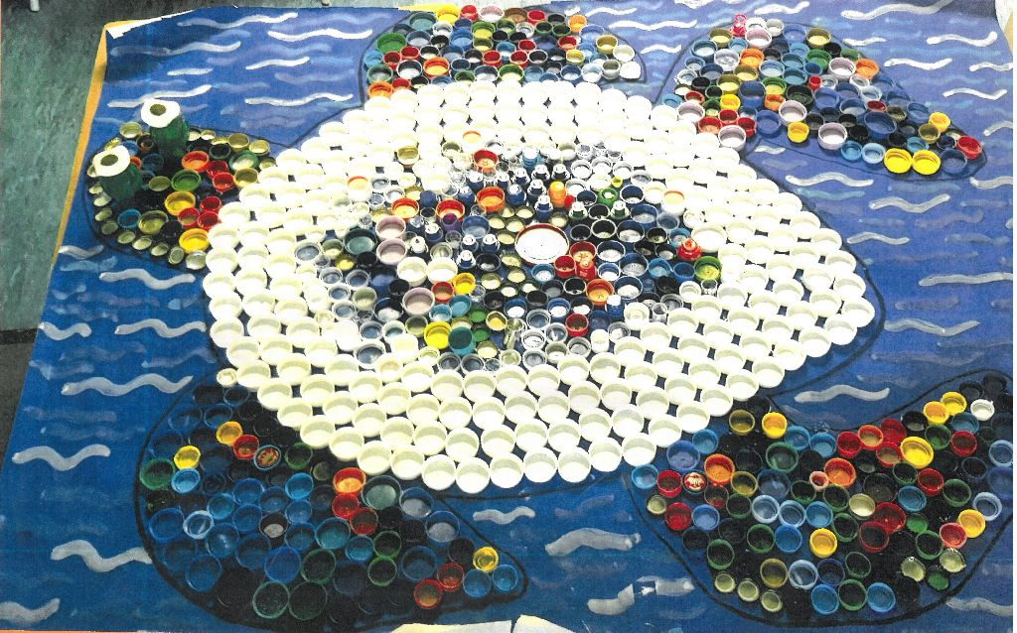


Charles, age 8 from St James Junior School C of E, made his artwork with the help of his classmates.
I do not believe in any religion or any God…After oceans arose and the first life forms appeared like fish and the Turtle I (with the help of my class) have created. The humans evolved from the life forms in the ocean and started inventing materials such as plastic. These plastics are destroying sea life and we have showed that in our artwork, that the turtle is covered and made from plastic. All the creatures are slowly dying, and they have the same value as humans. I believe if there was a God, would he really let this happen.

Slide 6
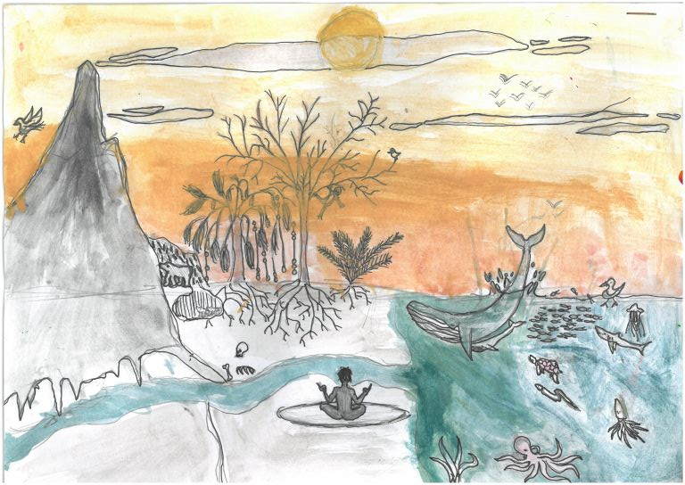

‘Planet Earth’
Alex age 11 from Widcombe CofE Junior school said:
A lot of people think of God as a special being that watches over us and aids us. I do not believe in God, but I think nature is a miracle. Our world is one of such diversity that we should love it with the same love we give God. In my opinion is as important as God. Earth is my special place.

Slide 7
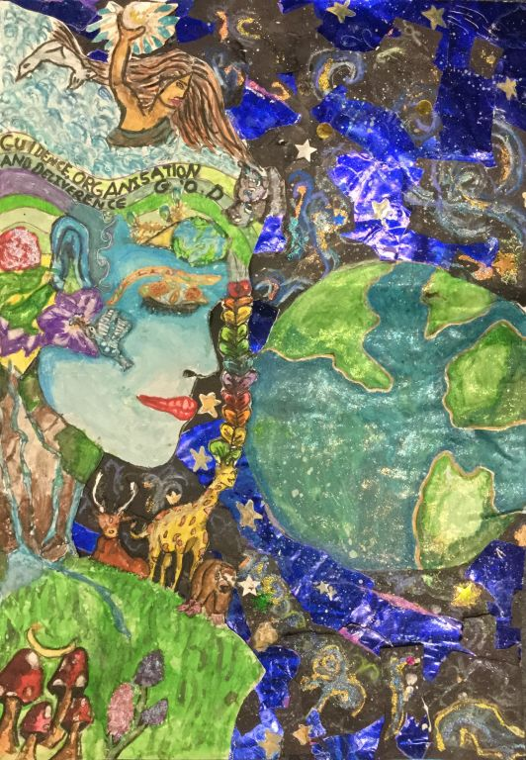

Isabelle, Charlotte and Astrid (all age 12) entered a group piece of artwork titled ‘Mother Earth’.
The religions that inspired our work were Hinduism and Paganism. Hinduism inspired us because of the Hindu belief that Brahman, the Hindu God, is in everything and is. But the original idea of Mother Earth came from the Pagan religion, based on the worshipping of nature and that God is like a mother because she has given us life and continues to sustain us.
This work is spiritual because it may remind people that the earth is a gift to us, we belong it and should look after it. This, therefore, is very relevant at the moment because humans are at a stage in their existence in which they really need to start caring and putting the earth and others before their own desires.

Slide 8
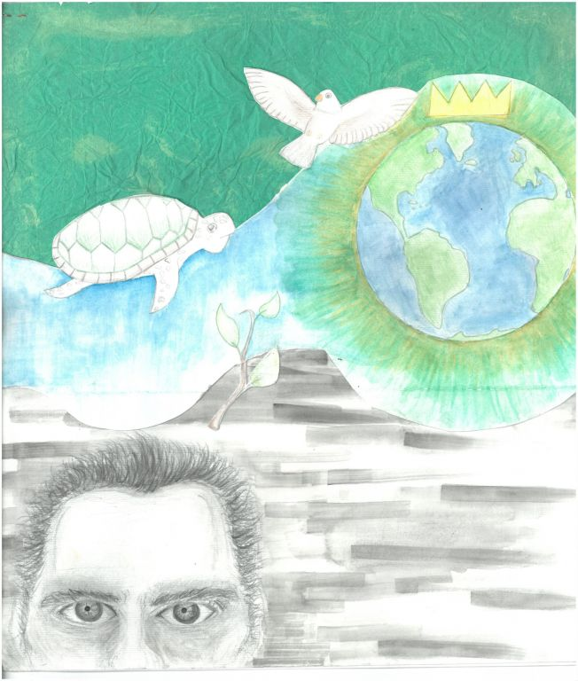

‘God’s Mystery’ by Amneek, age 14 from Stratford Girls Grammar School.
My painting is influenced by Job 12:7-10. The bottom half of the painting is in greyscale, to contrast with the bright colours above. This is to show that Job doesn’t see the full wonders of the universe – only God can see because he is omniscient, omnipotent and omnibenevolent. The man at the bottom is meant to be Job, and the river leads him to the Earth. I drew a plant, a dove and a turtle in reference to the old scripture: “But ask the animals, and they will teach you, or the birds in the sky, and they will tell you; or speak to the earth, and it will teach you, or let the fish in the sea inform you” (Job 12:7-8).

Slide 9
Why do the stars come out?
Kennedy, age 6
Why do the stars come out?
Why do we have names?
How far does the sea go?
How does the moon shine?
Why does a wasp sting?
Why is the grass green?
Why can’t we fly?
Why are the clouds in the sky?

Slide 10

I wonder: Gaia
Poppy, age 13
I wonder what it was like at the start,
When Gaia was a child
She cared for us, gave us life
We saw no poverty, no pollution, no strife.
…
I wonder what it I like now,
Backstage in the theatre.
Is Gaia on a torture rack,
As we search for coal, roughly breaking her back?
I wonder can we stop
The inevitable from happening,
Can we give our life giver
The chance not to wither?
You wonder why the natural disasters
Are repeatedly occurring.
Gaia see the backstage shows
Yes my friends she knows!!

Slide 11
Inspiring! | What inspired you? A song? A quote? Another person’s life? A place? Religion offers people inspiration to live. Sometimes an inspirational life, a person’s example, a text or a piece of music crystallizes our inspiration. In this theme, you are invited to identify what inspired you from a religion – it doesn’t have to be your own faith, as inspiration tends to spill over the edges of religions. Explain through your art and text what connects your inspiration to spiritual or religious life.

Slide 12
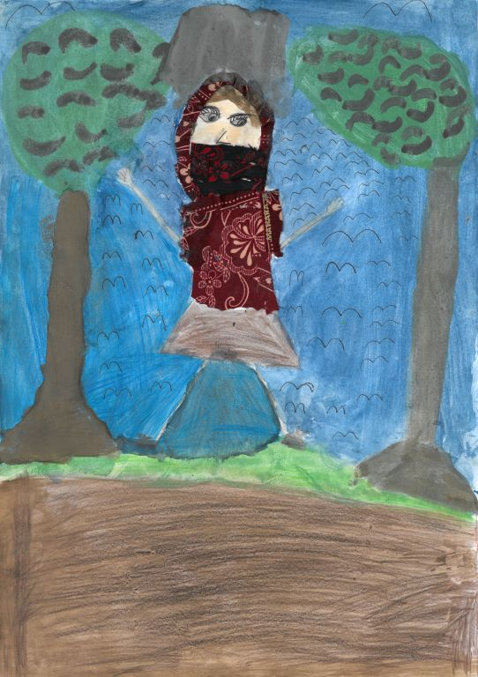

Hari, age 9, goes to St Leonard’s Lower school, and is inspired by Malala Yousafzia.
I am inspired by Malala Yousafzia because she fights for more education for all women. Her faith has given her strength to fight for peace and to not give up on education for women.

Slide 13
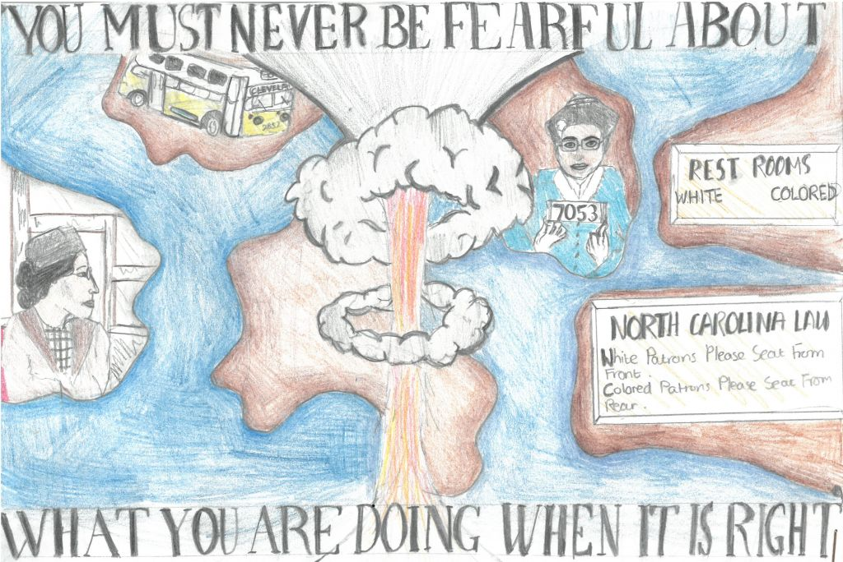
India and Orla, age 13, are from Manchester High School for Girls.
They were inspired by Rosa Parks and use their artwork to explore her standing up for what they believed in, and the consequences she faced.

Slide 14
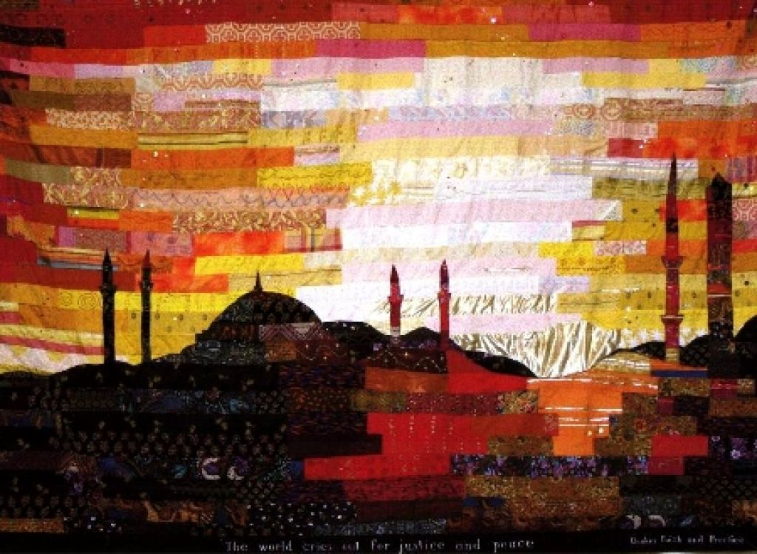
‘Open mind’ by Victoria and Samantha, both 15
‘We designed these t-shirts to represent being open minded. We thought if we did this on a t-shirt it would show people that you should be opened minded. We thought about what it would take to be open minded. The things we came up with on our t-shirt were loving each other which [is] represented by the giant love heart.
The different symbols represent different cultures and that we are all equal even if we believe in different cultures. The hands represent respect and peace. Being open minded means you can have your opinion but you still have to respect other people’s opinions.’
Olivia, age 14, was inspired by a visit to India. She created a painting then worked with her class to create a version as a giant wall hanging.
I loved to see the outlines of mosques and temples against the warm sky. Indian cities are very busy and noisy. Traffic rumbling and horns blaring. Music and voices and the squawking and bleating of birds and animals. At sunset you hear the echoey sound from the mosque calling Muslims to prayer. To me it was as if the imam was calling out for peace to come to this busy, restless world.
The words at the bottom are from Quaker Faith and Practice. The Quakers are known for their love of peace so I thought that these words matched the warm, peaceful feeling of the picture. Quakers respect all the different faiths of the world so although the picture shows a mosque, the words could be said by anyone of any religion.

Slide 15
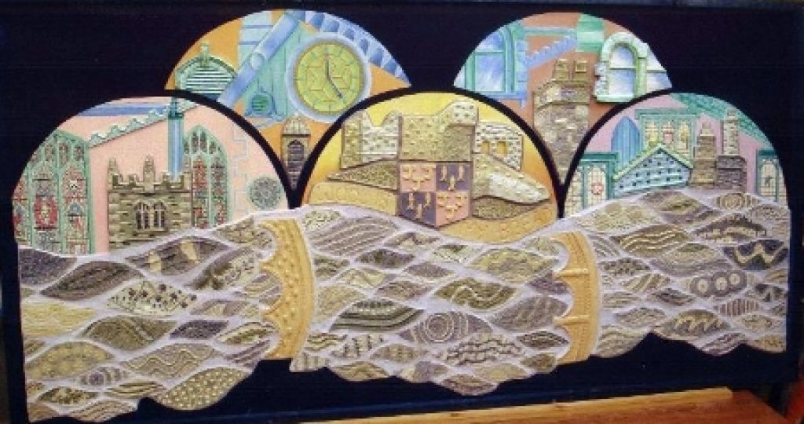
18-year-old Lauren created a 6ft x 4ft mural representing the architecture of her hometown – Kenda, Lake District.
As Gaudi (Spanish architect) said ‘The straight line belongs to man, the curved like belongs to God.’ Nature is used widely in the Bible to blend nature with God Psalm 121 v 1-2 ‘I look up to the hills, but where does my help come from? My help comes from the Lord, who made heaven and earth.’
The basic shape of my mural is that of the hills and river, with parts of the buildings inside the hills, as they are surrounding the town like the feeling that God surrounds us.

Slide 16
Inspiration (Mother Teresa)
Amy, age 13
I may have feet,
But I was unable to speak,
Until she came.
I looked into her gleaming eyes
And the shadows on her face.
She outstretched her loving arms
And held me in her healing embrace,
She blows kisses of love and despair
To me and all.
She is the light of my candle,
The voice to my choir,
And now I have gained a new desire
To have such valour and love
And to be talented like she.
She is like a rare stone
Whom people adore.
Time walks on,
People alive or gone,
She was always there,
That is what I wanted to share.
She was valuable,
She was a princess
She was Mother Teresa.

Slide 17
Holy Words! | What words are holy for you? Select a saying or story you really love about peace, faith, unity, prayer or some other religious theme. Incorporate your holy words into your design or art and express the value and meaning of the words you have chosen in the images and art that you make. This theme has a close connection to the study of holy books and teaching from 2 or more different scriptures can be used, so get reading from the Torah and the Gospel, the Qur’an and the Gita, the Dhammapada or the Guru Granth Sahib. And add some words from a non-religious source of wisdom too if you like.

Slide 18
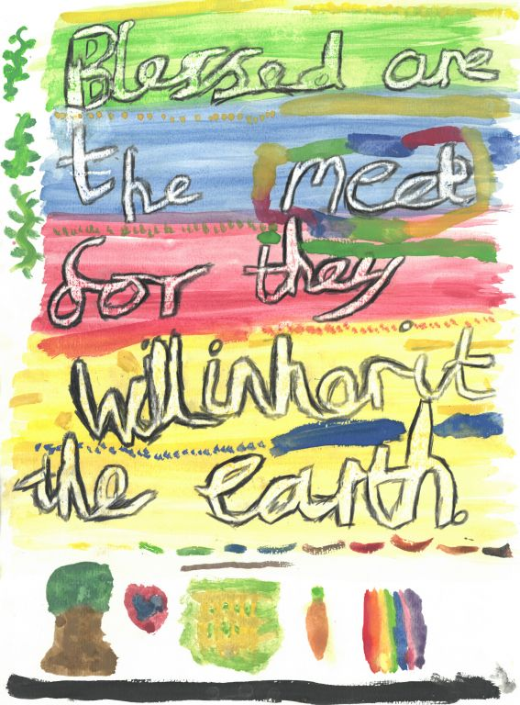
Daniel, age 9 from St Leonards Lower School shared his favourite beatitude.
I chose this beatitude because I liked what it meant and it was a very uplifting message to all people, also because it sounds very 'flowing' to me. This beatitude means you don't think of yourself and if you were a movie star you should think you're just as important as a homeless person, and the homeless person should think the same.

Slide 19
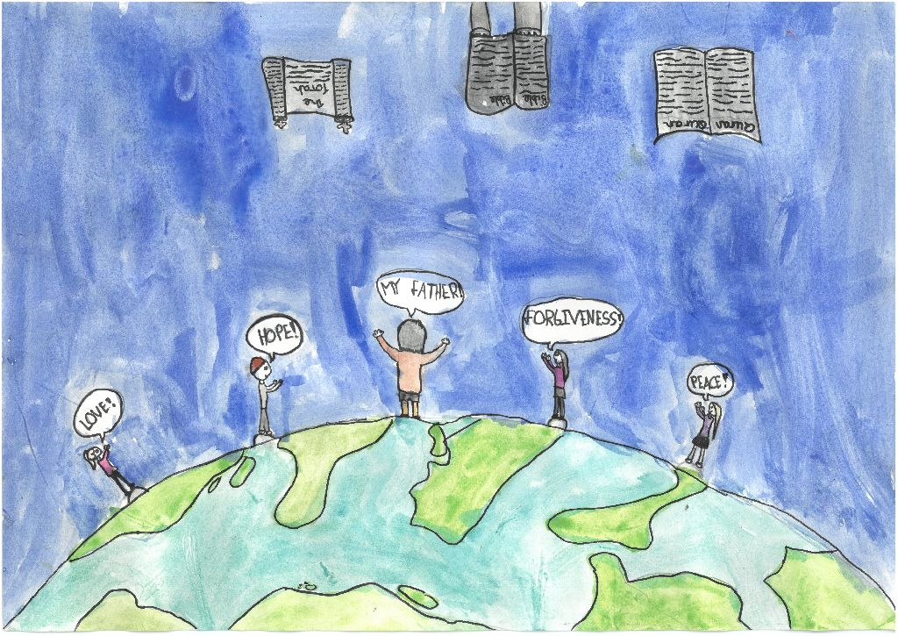

Gracie, age 9, from Borden CofE Primary School has shown different Holy texts.
The title I chose is, ‘The Word of God’ because Christians believe that all the Holy books, Bible, Qur’an and Torah Etc. are the words of God. I think that the words of God are love, peace and forgiveness, but there are many too many to mention. They aren’t the type of words that say to hateful.
In my picture I’ve drawn people on top of the Earth because they represent everyone, everyone should be forgiven and loved.

Slide 20
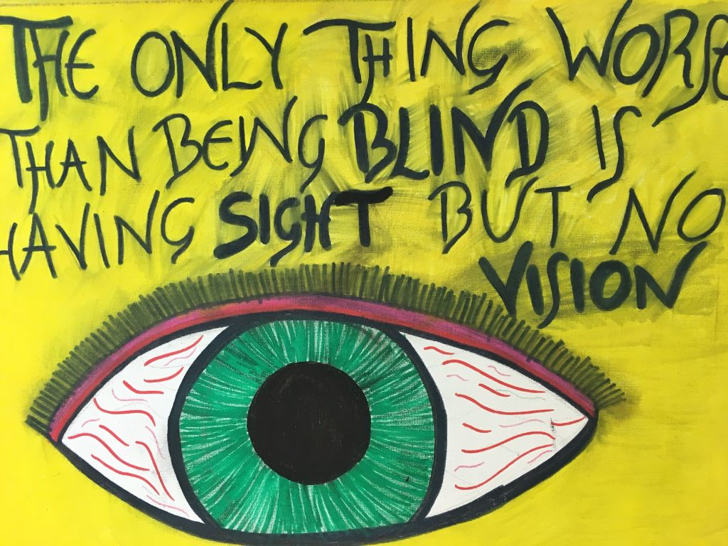

Ammaarah, age 12, from Witton Park Academy shared a personal reflection:
My art work has been inspired by my mother as unfortunately, she is blind. She has been blind for about nine years. She lost her eyesight when I was very young so she has never really seen what I look like. She always says that I am beautiful, and she sees visions of me. She says she is unlucky to lose her eyesight, but she is lucky to see visions. She says that it is Gods will to take away her eyesight, and she is not angry with him, as she knows that God will give her something better in the afterlife. My family’s religion is Islam, so we believe there is life after death, and my mother is confident that God has taken her eyesight away for a reason.

Slide 21
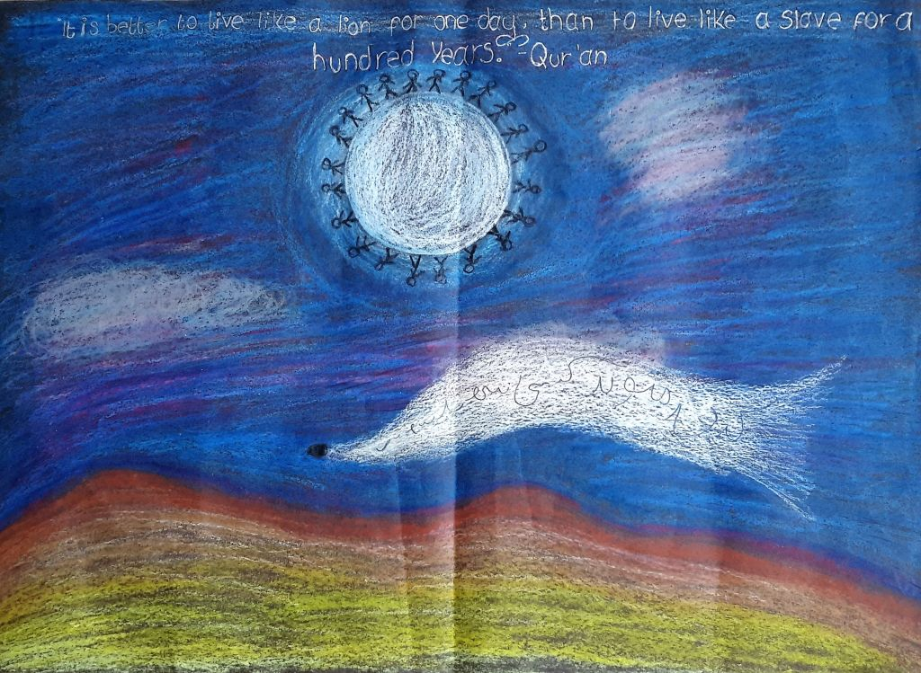
Garish, age 14, from Colton Hills Community School titled his artwork ‘Live like a lion.
My artwork is based upon the quote “it is better to live one day as a lion than 100 years as a slave”. On my artwork, there is a drawing of Malala, on the left hand side and there is a gun on the right hand side. In the middle I have placed the quote. Malala was named after Malala of Maiwand who led the Afghans into battle with this cry.
The message I tried to portray is that everyone has an option ~ they can live like a lion or a slave. I hope people will notice that you have the power to change your own life. I feel that Malala has empowered many people to change their lives today.

Slide 22
The wonders of the mind
Charlotte, age 10
An illusion of life,
Like a dark tunnel with a light at the end,
Remarks softly,
“Hallowed be thy name.”
Frozen breath,
Like a fast flowing river in spring,
Disappears swiftly into the breeze,
Whispering,
“Hallowed be thy name.”
…
The mystery of Heaven
Like a bboard game of skies and sea,
Mutters,
“Hallowed be thy name.”
The power of God,
Like a gigantic force of love and hope
Says aloud,
“Hallowed be thy name”
[repeat final verse]

Slide 23
Where is God? | Atheists, agnostics and believers in God might all respond to this by expressing their sense of the search for God or finding God. Where’s God? In your heart, in prayer, in the temple or the universe? Or is she hiding? Is he not there at all? Looking for God, searching for him or her, matters: but how are we doing in finding God? Would you search with google or a ‘goddetector? Is God on Instagram or WhatsApp? Can God be found by prayer or by looking among the world’s suffering people? This popular Spirited Arts & Poetry theme produces great work where pupils use ideas from religions clearly: The Jewish Psalms 42 and 43 are where it starts.

Slide 24
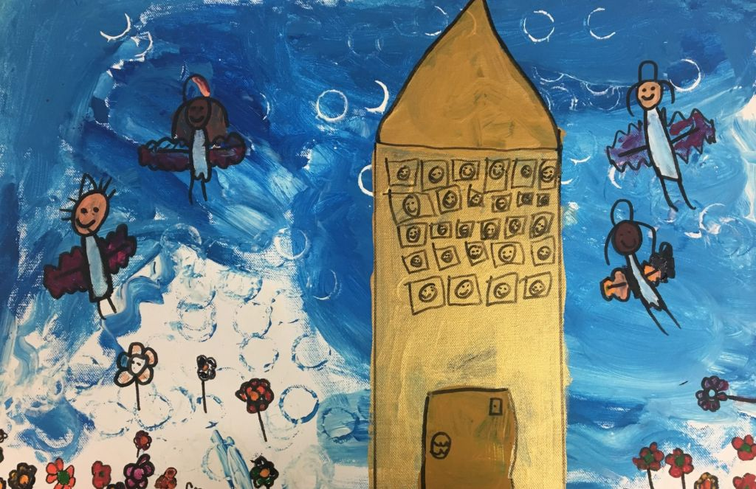

Hope, Alice and Marley (all age 5) from Benedict Biscop CE Academy worked together to answer the question, ‘Where is God?’.
God is on Heaven. He is everywhere. Heaven is God. Heaven is in the sky. God isn’t a man or a woman, he is everything and everywhere. I wish I could see God and say thank you for making the world. Heaven looks like the sky, so we need blue colours. We need white too, for the clouds. And Gold for the Angels. We need beautiful flowers in it too remember. Heaven is full of all different flowers.

Slide 25
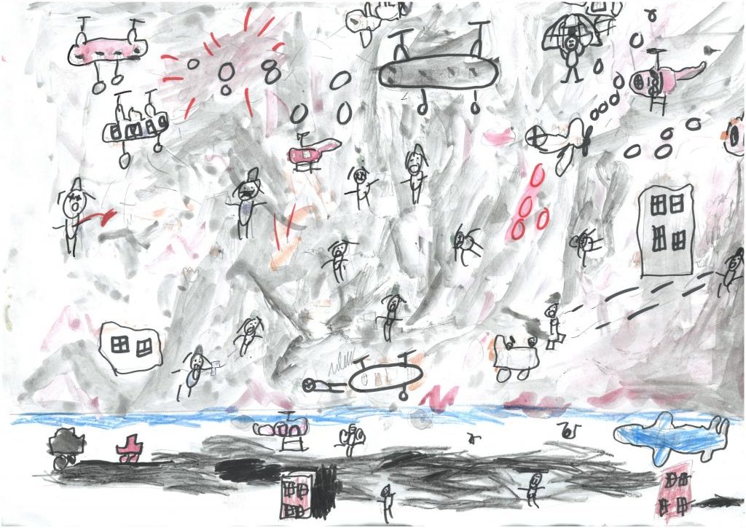
Deen, age 7, from Balderstone St Leonard CofE Primary School says:
Where is God when all these wars are happening? At first it is difficult to see. But if you look again you can see people helping, people being brave, and young children still playing. That is where I think God is!

Slide 26
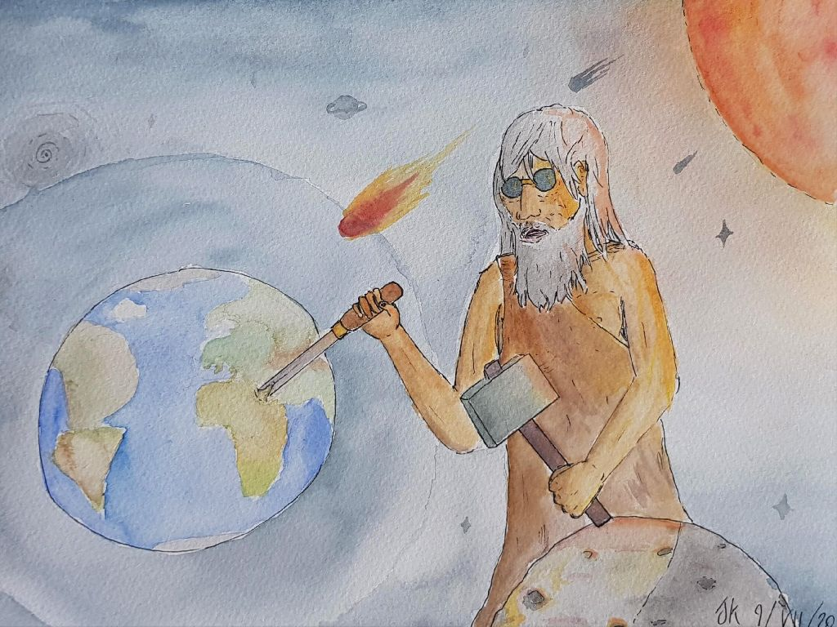

James, age 13, from Warwick School called his piece ‘Making or Marring?’
…it shows an omnipotent figure carving the world, while not explicitly stating that the figure is God. Is this figure a creator or a character manipulating the surrounding that already exists? The picture may represent the universe but equally it could represent its marring. At first glance, because my piece is figurative, it is very easy to think that it represents a creator at work, but I also wanted to introduce a sense of ambiguity...is this figure enhancing our world or destroying it? Is this figure shaping Africa lovingly or tearing the continent apart?

Slide 27
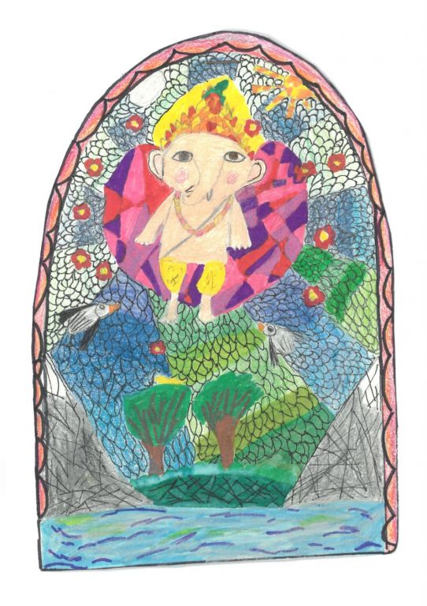

10-year-old Niyati from Church Hill CofE Junior School says:
I feel that God is everywhere that's why I have drawn rivers, mountains, greens, the moon and sun and the most important part is he is in my heart and he supports everyone in the world. The colours represent calm and peace around God and that he makes peace in the world.

Slide 28
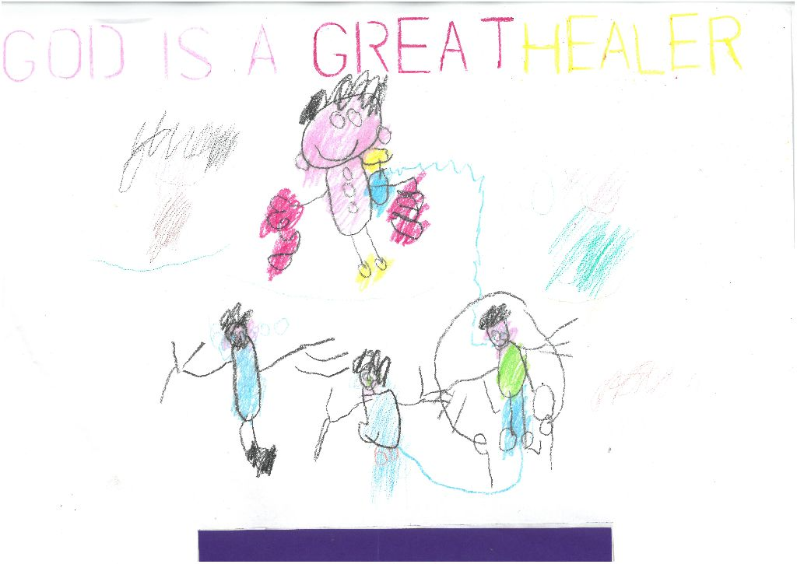

Isobelle, age 17, from Newman Special School is one of our SEN winners. She shared a moving piece:
God is up in the sky waiting for my arrival. So he can sprinkle down a healing potion to make me see and walk again and my parents standing beside me crying with tears of joy I say ‘I can see and walk again, thank you God’.

Slide 29
Hope in the darkness
Stuart, age 11
I walk to see my hero die,
As tears gather in our collective eyes.
A broken Jesus holding a cross,
All hope in me was lost.
Whipped and beaten in thunder and lightning
I felt like a thousand angles lost their wings
Weak and trembling he got tied by his wrists
As he screamed in pain in the dark mist
He turned his head to see a weak and blonde man
He was a murderer and when caught, ran.
He did crimes and didn't care,
The punishment for this sinner was totally fair.
After that he turned to the right,
A guilty man full of fright.
Although his actions were sick and gross,
He was truly sorry and that's hat matters most.
Beside him two men. One evil one great,
They thought that forgiveness in them was way too late.
They were all going to their eternal rest,
Just then Jesus showed the hope in the darkness.

Slide 30
Picturing Faith (Photo section!) | This is an innovation for our Spirited Arts competition. Pupils are invited to select up to 4 photographs from a visit to a place of worship (or another trip connected to RE) – preferably those taken by themselves, and give a brief commentary on the pictures to say what was great and what they learned from their visits. Comments about the emotions and the purpose of the place, not just ‘labels and captions’ are best. Pupils may like to provide their commentary in the form of a poem. We suggest they are sent in a PPT presentation (or similar). If you have another way of responding to the theme ‘Picturing Faith’ then that is fine, please do send it in!

Slide 31
And what about you?
You have seen a lot of examples of the brilliant entries to the Spirited Arts & Poetry competition.
Now think over your own ideas, beliefs and skills.
Plan to make a super entry of your own, to send in before the end of the Summer Term. The closing date is 31 July 2020.
Write about how good it is! You can use the prompts we suggest. Up to 250 words maximum.
Don’t forget you can see hundreds of interesting entries and other winners on the online gallery. Click here.
Good luck!

