Slide 1
Notes:
de 1: Use your usual gathering greeting to welcome your school community

Slide 2
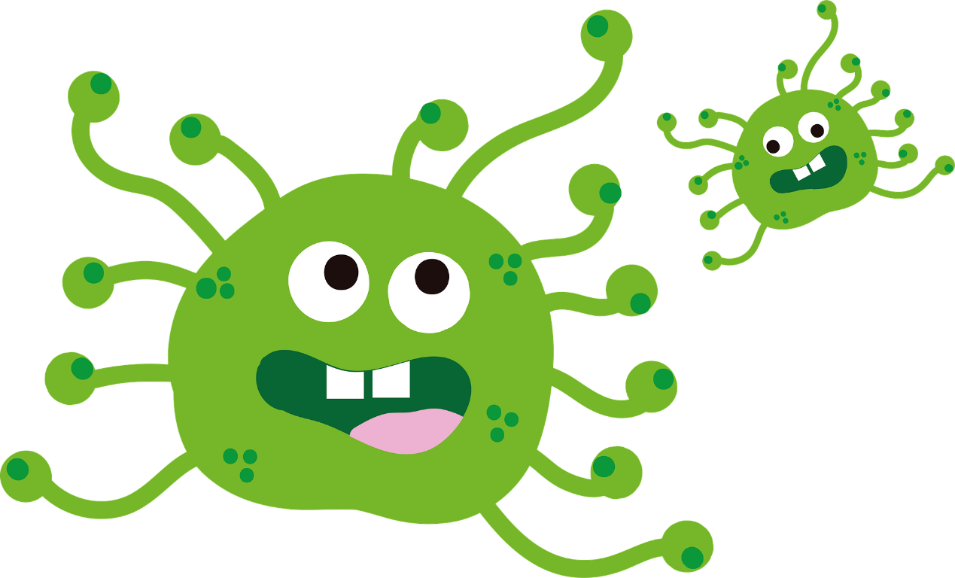
Pictures in this presentation are copyright-free from pixabay
Notes:
Slide 2: Show the ‘germ’ picture and ask children what they think it represents. ‘By now, we all know quite a lot about this new germ – known more specifically as ‘COVID-19’, or ‘Coronavirus’.

Slide 3
Notes:
Slide 3: ‘We know that doctors, nurses and scientists are doing everything they can to help find a medicine to make people better and to look after people who are ill in hospital.

Slide 4
Notes:
Slide 4: ‘We know that sometimes it’s been hard to buy food in our shops….and that this may mean we can’t get our favourite things for a while…

Slide 5
?
Notes:
Slide 5: ‘….that we might have to do some other things differently for a while, maybe even doing school differently…. And that there are a lot of questions that we don’t really have answers for at the moment. You might need to talk about these later on in class, to your teacher, or to your family at home……

Slide 6
Jesus’ Lesson
Notes:
Slide 6: ‘But today, we are going to think together about some things that we can do at this point in time…and we’re going to start with something that Jesus said: in fact a lesson that he taught….

Slide 7
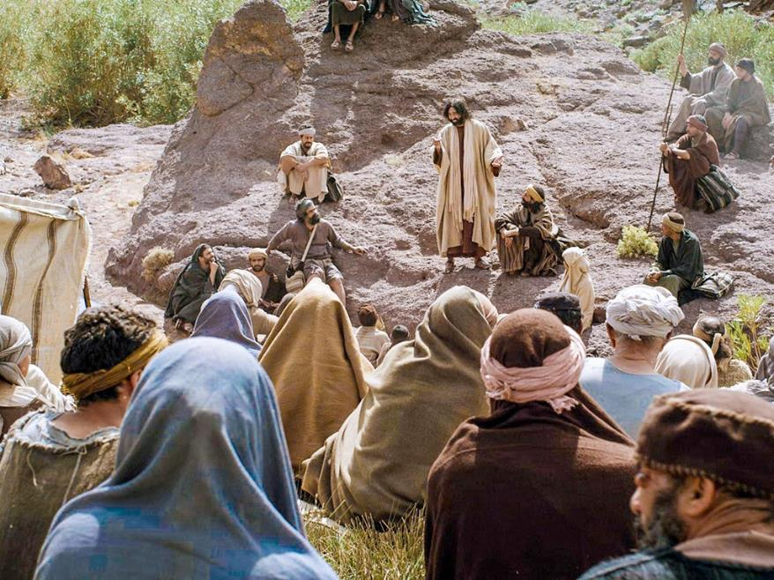
Notes:
Slide 7: ‘….not in a classroom, but outside on a hill – to people of all ages, men, women and children. People had come from all over the countryside to hear what he had to say and, as people always did, they brought with them all their worries and concerns. And so Jesus had this advice for them [words taken from Matthew 6, ICB translation]:

Slide 8
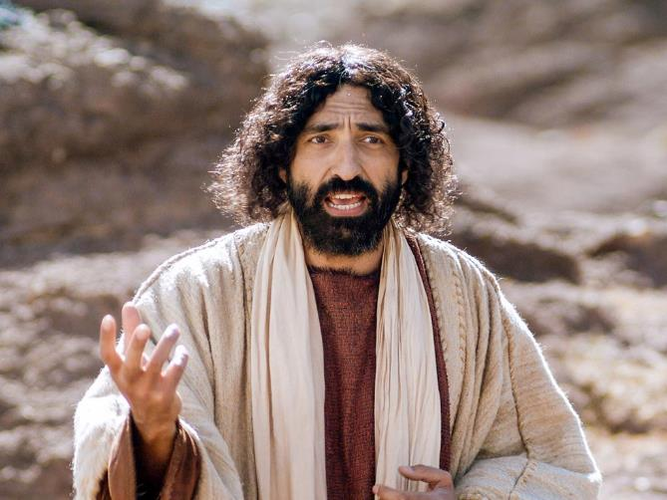
Jesus said: ‘Don’t worry….’
Notes:
Slide 8: Jesus said “So I tell you, don’t worry about the food you need to live. And don’t worry about the clothes you need for your body. Life is more important than food. And the body is more important than clothes.

Slide 9
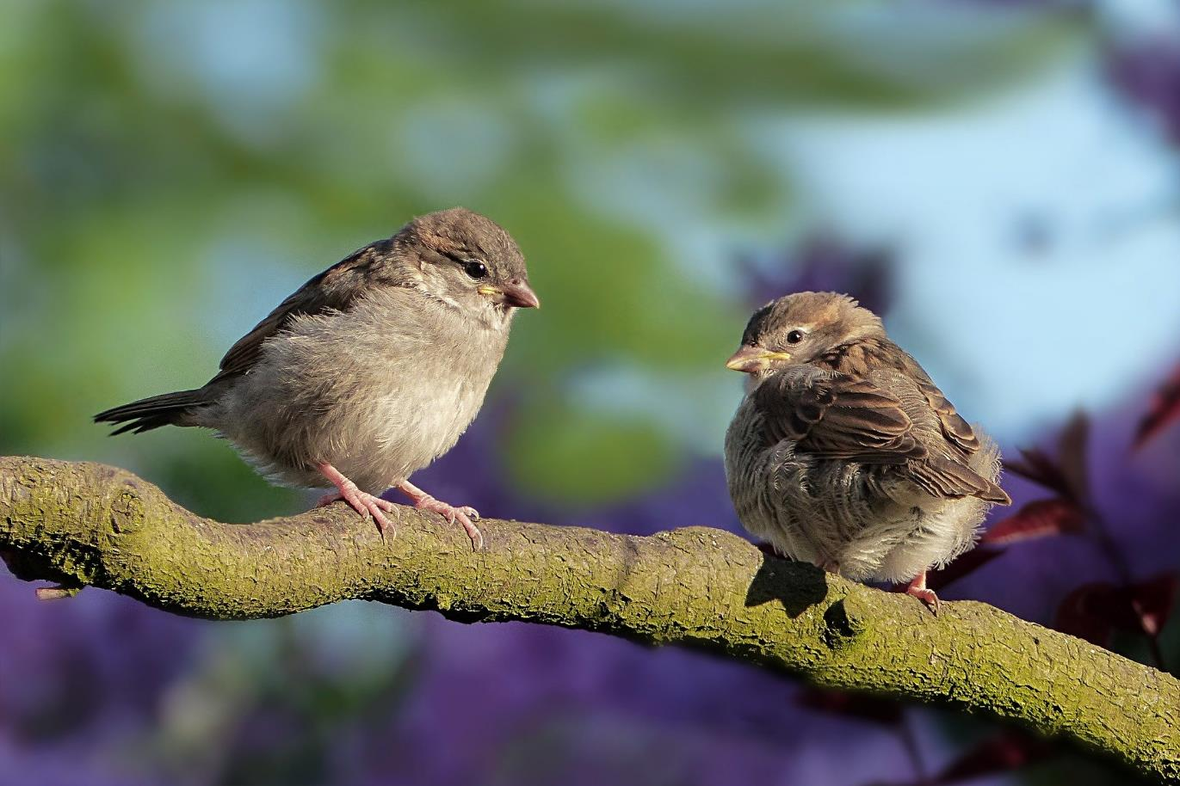
Jesus said: ‘Look at the birds…’
Notes:
Slide 9: Look at the birds in the air. They don’t plant crops or harvest or store food in barns [or buy food from supermarkets!]. But God your heavenly Father feeds the birds. And you know that you are worth much more than the birds. You cannot add any time to your life by worrying about it. Why do you worry about clothes?

Slide 10
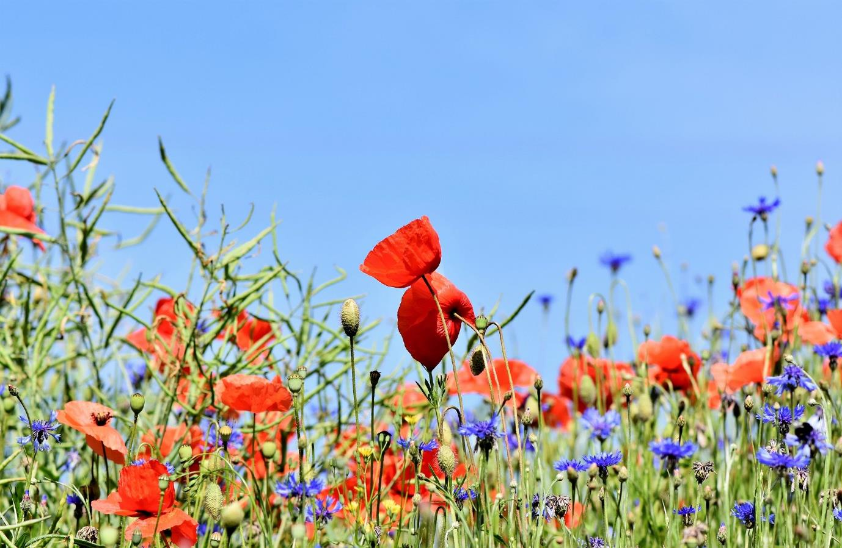
Jesus said: ‘Look at the flowers…’
Notes:
Slide 10: Look at the flowers in the field. See how they grow. They don’t work or make clothes for themselves. But I tell you that even great King Solomon with his riches was not dressed as beautifully as one of these flowers. God clothes the grass in the field like that.

Slide 11
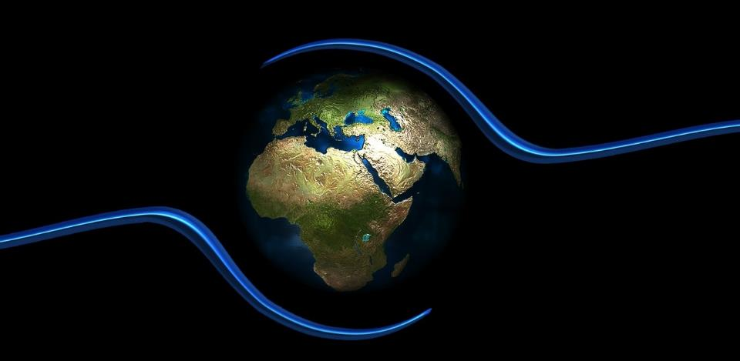
Jesus said: ‘God cares…’
Notes:
Slide 11: …..So you can be even more sure that God cares for you.”
It might be hard to understand lots of things at the moment, but for Christians all over the world and for us as a church school community, the words of Jesus can bring comfort and hope in these difficult times. And we know that there are things that we can do….

Slide 12
Notes:
Slide 12: Let’s go back to our germ picture….we’ve been talking a lot over recent weeks about hand-washing, haven’t we?!

Slide 13
Notes:
Slide 13: This short clip shows the effects of soap on germs: just to reassure you, the water is not really full of germs, but it’s pepper grains that look like dirt, which represent the germs that we can’t normally see. Watch what happens when the ‘germs’ come into contact with soap!....

Slide 14
Notes:
Slide 14: We all know how important it is for us each to responsible in washing our hands to try to keep ourselves and our families healthy – so we can all do that, and sing ‘happy birthday’, twice, to each other while we do!

Slide 15
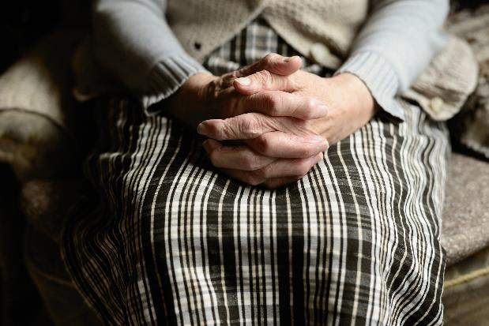
Help each other
Galations 6:2
Notes:
Slide 15: And there are other things we can do as well. We can talk to each other …. about our worries and concerns, whether we have a little mouse-sized worry or a big elephant-sized worry. In our neighbourhoods, we might have old people who are feeling alone. We might not be able to visit them, but we could write them a letter or draw them a picture to let them know that we are thinking of them and to cheer them up… They might need our help to get them some shopping because they’re not able to go out themselves….. and we can do lots of other things to help each other during these times: maybe helping each other with homework, or household chores (even the ones you don’t like!), or playing with little brothers and sisters.

Slide 16
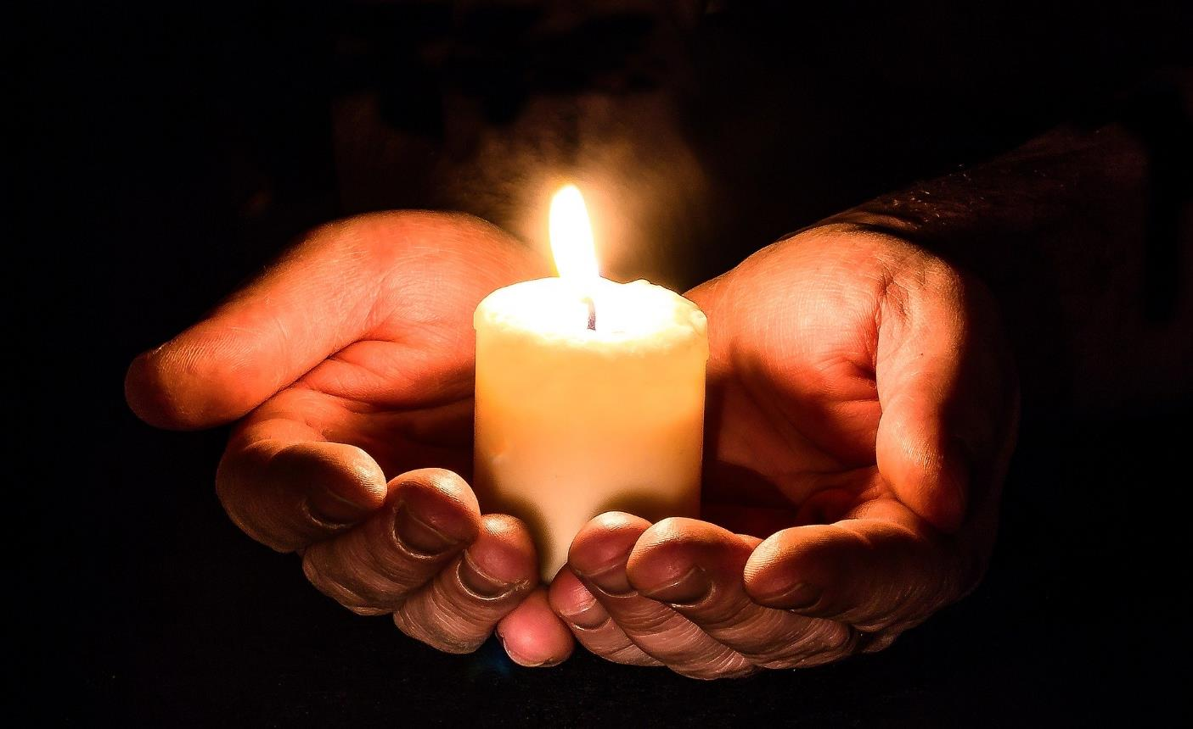
Give all your worries to God
I Peter 5:7
Notes:
Slide 16: And if we want to, we can pray about all these things too. Some more words from the Bible say ‘Give all your worries to God’, which is what we’re going to do in a few moments, but first let’s be still and quiet…… [go on to the reflection section: there are some words & pictures for your school community in the PowerPoint, but you might prefer children’s eyes to be closed]
…We’ve been thinking today about the words of Jesus to the crowd….
…words that are especially important to Christians all over the world….
….that as God cares for the birds and the flowers of the fields, he cares even more for people….
….we’ve thought about the challenges that lie ahead of us….
….and about the things that we can do, especially how we can show we care for the people around us…
….our friends, our families, our communities….
….and that if we are worried, we can share how we are feeling with others….
I’m going to turn my thoughts into a prayer now, as I ask God to help us. There’s a part you can join in with if you’d like to make the prayer your own: the words are really easy [and will be on the screen]…but if you’d prefer not to pray, then just sit quietly with your own thoughts.

Slide 17
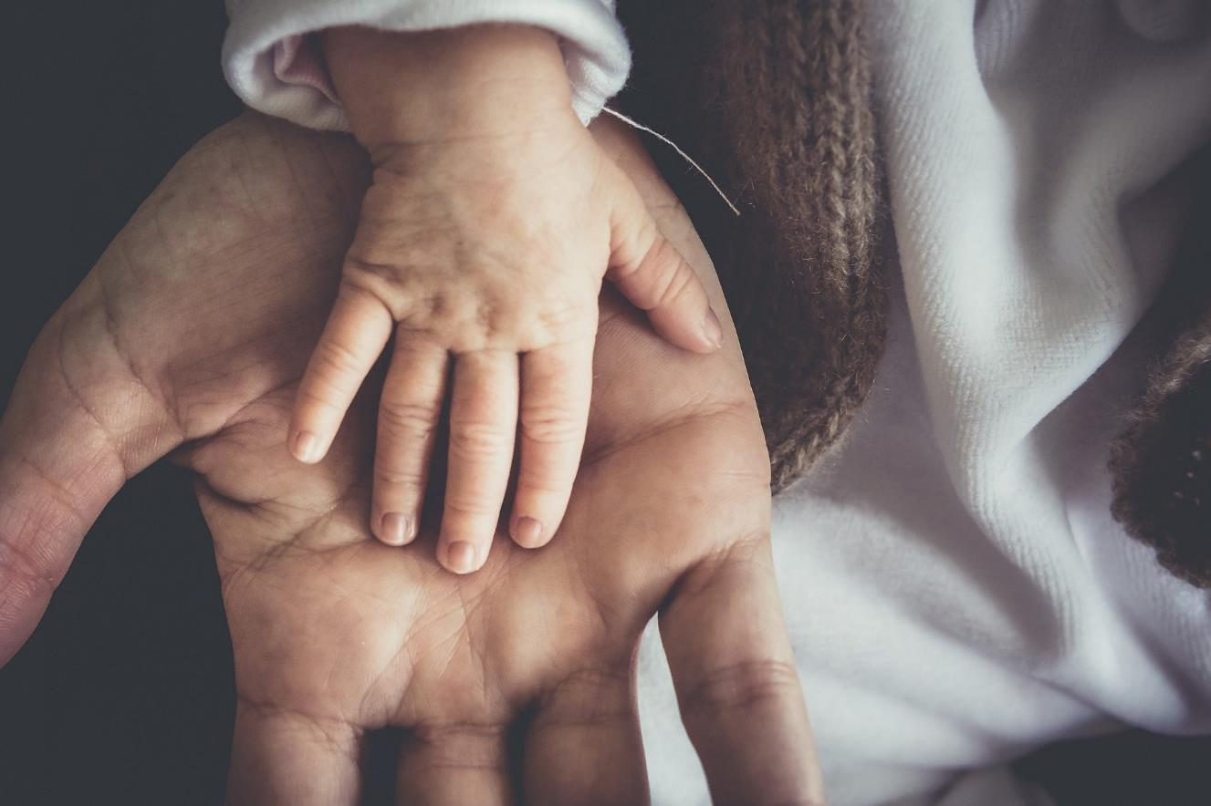
Thank you that you care for us
Notes:
Dear God
[Slide 17] Thank you that you care for us

Slide 18
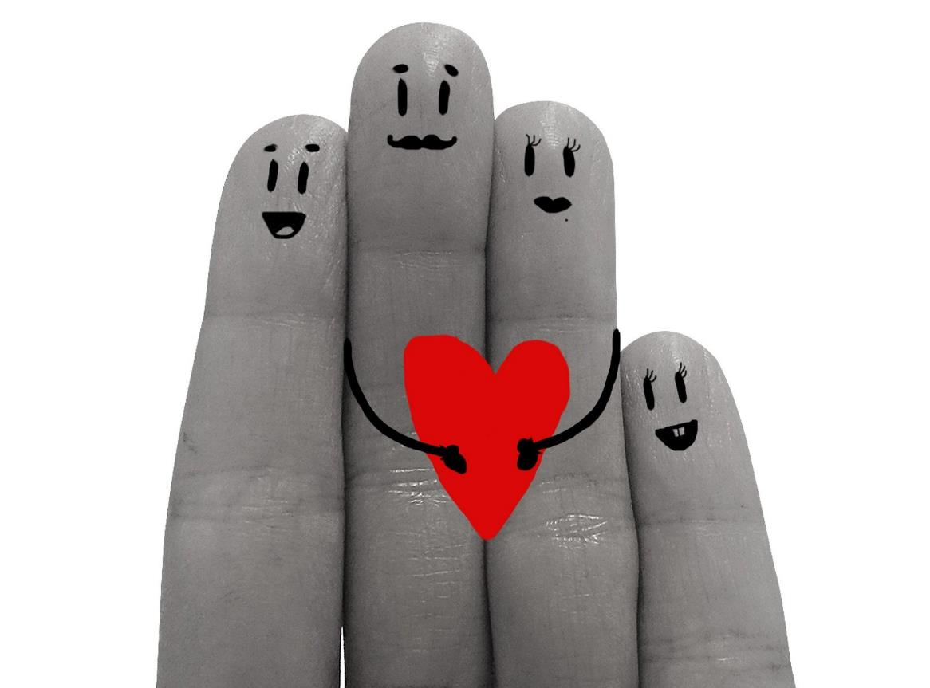
Thank you that you care for them
Notes:
[Slide 18] Please look after my family, those who live near me and those who are far away
Thank you that you care for them

Slide 19
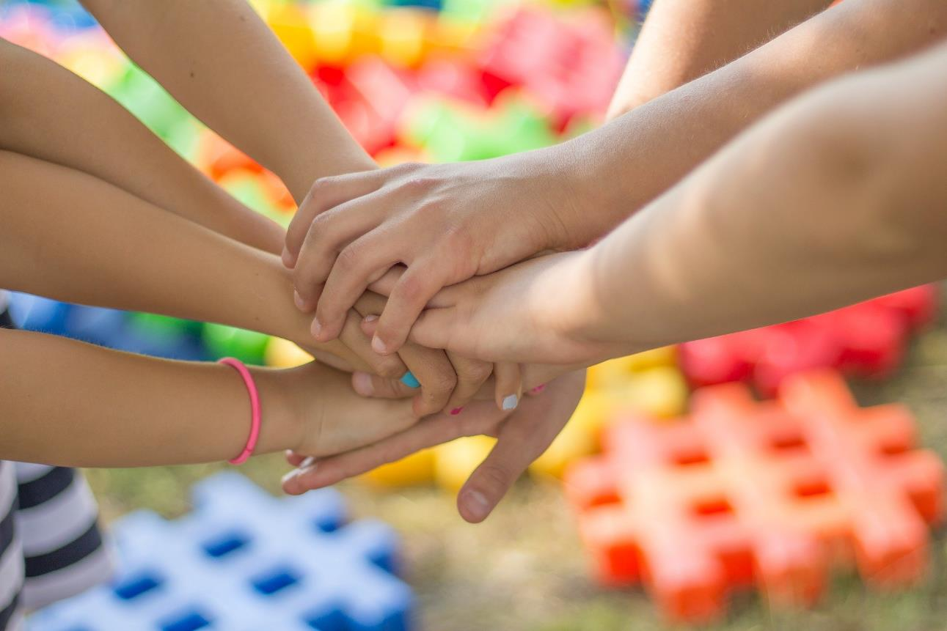
Thank you that you care for them
Notes:
[Slide 19] Please look after my friends, my class and my neighbours
Thank you that you care for them

Slide 20
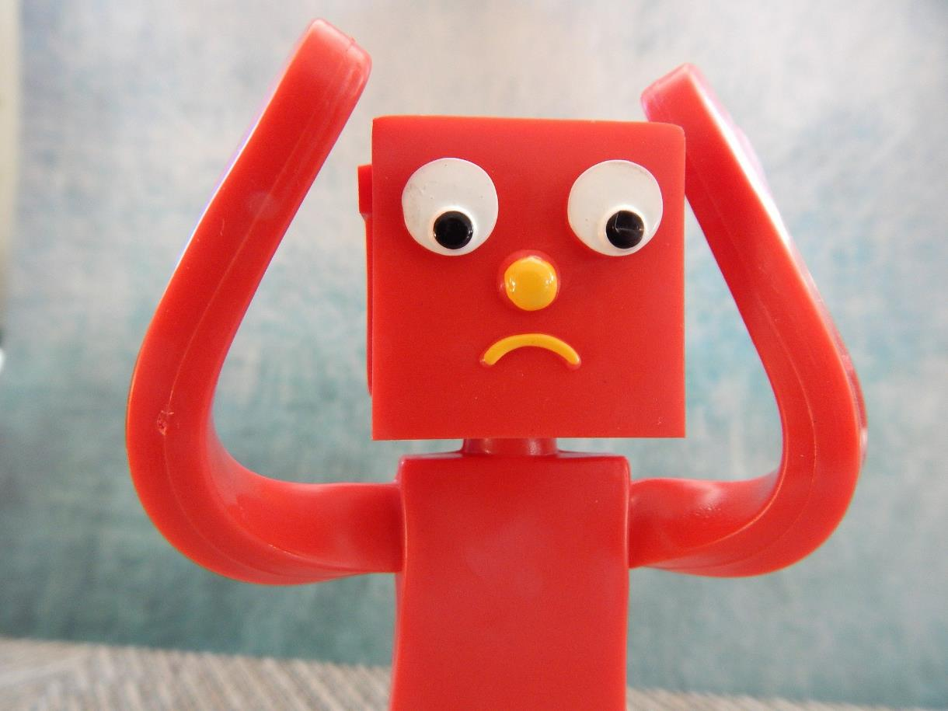
Thank you that you care for me
Notes:
[Slide 20] Please be with me if I feel worried or anxious
Thank you that you care for me

Slide 22
Live lovingly
Notes:
Slide 22: So let’s remember that even in the middle of these difficult times, we can still show we care for those around us. Let’s live lovingly.

