Slide 2
The ship of schools

Slide 3
Ezekiel

Slide 4
The ship of schools

Slide 5
gubernator noun gu·ber·na·tor \-ˌnātə(r)\

Slide 7
gubernator noun gu·ber·na·tor \-ˌnātə(r)\

Slide 8
The ship of schools

Slide 9
Training or learning?
Data
Pupil premium
Compliance
Wisdom
Experience
Insight

Slide 10
Wisdom
Experience
Insight

Slide 11
The ship of schools

Slide 13
The ship of schools

Slide 14
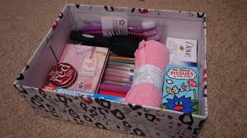

Slide 15
The ship of schools

Slide 17
www.rightprogrammeoxford.org

Slide 18
The RIGHT elements
Team
Structure
Networks
Tools
Emphasis
Support
Outcomes

Slide 20
www.thinkinggovernance.org

Slide 22
The ship of schools

Slide 23
Value wisdom
Use experience
Prize insight

Slide 24
gubernator noun gu·ber·na·tor \-ˌnātə(r)\

Slide 26
mark@question-mark.org
07811 696144

